Slide 1
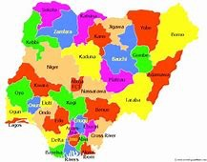
Nigeria
Action Plan
on the Adoption of Digital Agriculture

Slide 2
Key Ideas
Application of Digital Agriculture Technologies
Leverage on Partnership and collaboration
Provision of digital devices to Facilitators/Extension Agents/farmers
Continuous Capacity and Skill development on digital literacy is necessary

Slide 3
Agribusiness Constraints
Policy and regulatory environment
Credit and Incentives
Infrastructure and Mechanization
Market and supply securities

Slide 4
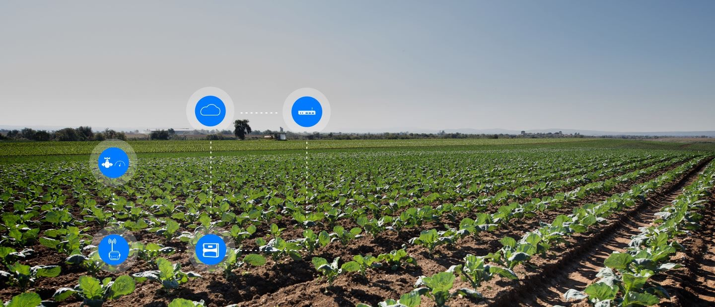
DATs Solutions
Build data Infrastructure , remote sensing and Agri geo- mapping tech. to enable data driven decision making and policy
Create platforms to link farmers to credit, insurance and saving products
Provision of tools to help farmers produce high quality, high yield crops, as well as digital platform to sell farm produce
Provision of CSA tools to deal with climate change
Provision of platform to deliver information in real -time directly to farmers

Slide 5
Action Plan
Short Term (1-3 years) | Medium Term (3-5 years) | Long Term (5-10 years)
Advocacy to all the 3 tiers of Govt. on DATs solutions to Agricultural challenges | Research and Development on agricultural digital Solutions | Provision of fund for Research , Extension and Development on agricultural digital Solutions
Sensitization and mobilization of groups of Youths and women across the 774LGAs | Sensitization and mobilization of groups and Youths across the 774LGAs
Capacity Building and Skill development onagricultural digital literacy for youths and women e.g on CSA, Geospatial tech | Capacity Building and Skill development on agricultural digital literacy for youths and women e.g CSA,Geospatial tech | Capacity Building and Skill development on agricultural digital literacy for youths and women e.g CSA,Geospatial tech
Collaboration and Partnership with Private and Public Institutions on DATs | Collaboration and Partnership with Private and Public Institutions on DATs | Collaboration and Partnership with Private and Public Institutions on DATs

Slide 6
Action Plan
Short (1-3 years) | Medium | Long
 | Building of Data Infrastructure , remote sensing and mapping technology | Building of Data Infrastructure , remote sensing and mapping technology
 | Provision of necessary Infrastructure facilities at all levels | Provision of necessary Infrastructure facilities at all levels
 | Provision of DATs devices to farmers(Youths and Women) at subsidized rate by govt. | Provision of DATs devices to farmers(Youths and Women) at subsidized rate by govt

Slide 7
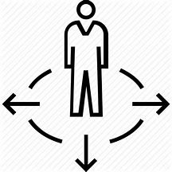
Opportunities and Barriers
Opportunities- Active youths population, Existing Public/Private Partners, Willingness of Govt to invest in Infrastructure
Barriers- Unavailability of funds, Social Cultural Issues, Government Policy Direction, Land use issue, Connectivity, knowledge and Skill gap

Slide 8
Technical Support Needed
Inclusion of DATs solutions to new Projects/Intervention support, as well as restructuring of on-going Projects to include DATs solutions
Advocacy and Sensitization by Development Partners to Govt officials on the paradigm shift in the agricultural space
Continuous capacity building of all Stakeholders by Development partners
Experience sharing and follow up on the Knowledge exchange on Digital Agriculture
Provision of Govt. support to start up and incubation.

